Slide 1
Tutorial- Physics-driven Multi-Objective Bayesian Optimization (MOBO)
Arpan Biswas
Postdoctoral Research Associate, ORNL

Slide 2
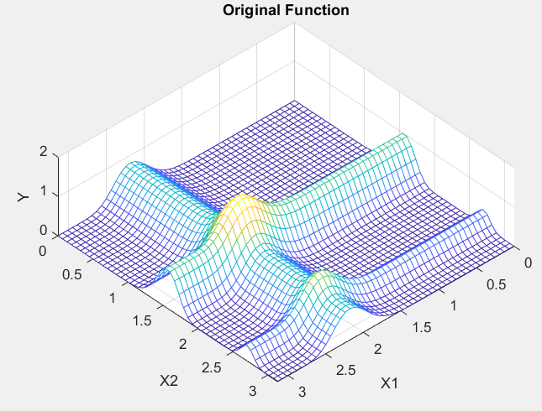
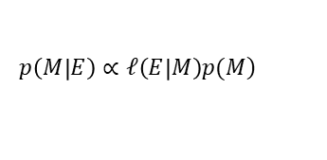
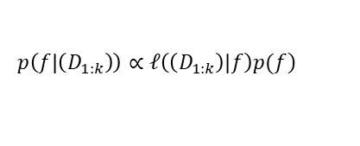
Bayesian Optimization (BO)
Current evaluations
Posterior surrogate model
Select future evaluations
Why called “Bayesian” ?
Bayes Theorem
Expensive evaluations
$$\left.p\left(M | E\right)∝𝓁\left(E | M\right)p(M\right)$$
Augment current and new evaluations
Evidence
Parameter
BO setting:
$$\left.p\left(f | \left(D_{1:k}\right)\right)∝𝓁\left(\left(D_{1:k}\right) | f\right)p(f\right)$$
Posterior Model
Data
Unknown function

Slide 3
Bayesian Optimization (BO)
Gaussian Process
Acquisition Function
Expected Improvement
Probability of Improvement

Slide 4
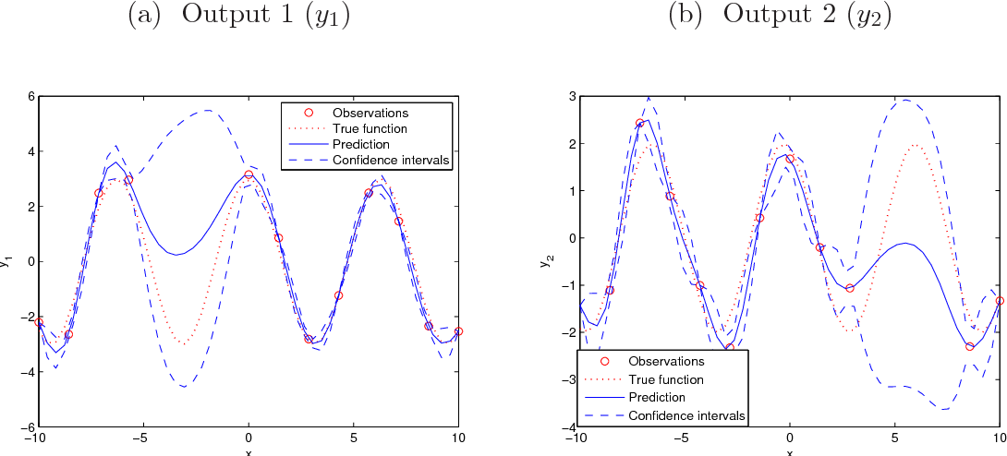


Multi-Objective Bayesian Optimization (MOBO)
Multi-objective Optimization:
Multi-objective Bayesian Optimization:
$$\min{f\left(X\right)=\left[{minf}_{1}\left(X\right), minf_{2}\left(X\right), …. minf_{n}\left(X\right)\right]} s.t X∈ℝ$$
$\min{f\left(X\right)}$where $f\left(X\right)$ is expensive to evaluate
Multi-output Gaussian Process

Slide 5
Multi-Objective Bayesian Optimization (MOBO)
Multi-objective Optimization:
Multi-objective Bayesian Optimization:
$$\min{f\left(X\right)=\left[{minf}_{1}\left(X\right), minf_{2}\left(X\right), …. minf_{n}\left(X\right)\right]} s.t X∈ℝ$$
$\min{f\left(X\right)}$where $f\left(X\right)$ is expensive to evaluate
Hyper-volume acquisition function
Weights NOT defined
Posteriori Approach
Priori Approach
Iteration 1
Ideal solution
Iteration 2
Ideal solution
f₂
f₂
Increase HV
HV
HV
Reference point
f₁
Reference point
f₁

Slide 6
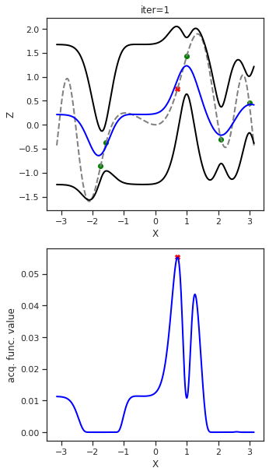
Multi-Objective Bayesian Optimization (MOBO)
Multi-objective Optimization:
Multi-objective Bayesian Optimization:
$$\min{f\left(X\right)=\left[{minf}_{1}\left(X\right), minf_{2}\left(X\right), …. minf_{n}\left(X\right)\right]} s.t X∈ℝ$$
$\min{f\left(X\right)}$where $f\left(X\right)$ is expensive to evaluate
Hyper-volume acquisition function
Weights PRE defined
Posteriori Approach
Priori Approach
Iteration 1
Iteration 2
f₂
f₂
HV
HV
Increase HV
f₁
f₁
2D objective space
2D objective space
1D multi-objective space

Slide 7
Case Study1 (MOBO)
Numerical Test Problems (Non-Physics): ZDT1
Acquisition Function: qEIHV (Posteriori); Batch_size: 4, Max BO sampling: 50 x Batch_size
f₁
f₂
Ground truth
Building Pareto over design space
Building Pareto over objective space

Slide 8
Initialization:
Define parameter space,
Select target functions,
Select acquisition function,
Set maximum BO iteration,
Set batch size,
Define external field
Select initial points (random)
Physics driven MOBO
Data Augmentation:
Augment Training Data with current and new evaluations
Numerical generative model: 2-4-6 KLGD bulk PZO
Posterior modelling:
Fit GP models for each objectives
Configure hysteresis loop
Train GP:
Optimize hyper-parameters (minimize loss) of each GP models using appropriate optimizer, (eg. Adam) given the training data
Develop physics driven decision tree
Outside MOBO framework
Within MOBO framework
Function evaluation:
Quantify target functions as user selected for objectives
Posterior predictions of unexplored points
Search Strategy:
Choose new points (in batch) from user selected MOO-based acquisition function
Is maximum BO iteration reached?
No
Yes
Stop Model and build Pareto-frontier

Slide 9
Case Study 2- Physics driven Decision Tree
Case Study Theoritical Model: 2-4-6 KLGD for bulk PZO
proposed by -- Anna N. Morozovska and Sergei V. Kalilin,
developed by -- Eugene A. Eliseev (in Mathematica) and Arpan Biswas (in Python)
Hysteresis Loop
Zero Loop (PE)
One Loop (FE)
Two Loop (AFE)
Total Energy
Linear
Loop Width
No shift
Sigmoid
No separation
Energy Storage
Loop Shift
Positive (right) shift
Two waves
Separation
Energy Loss
Negative (left) shift

Slide 10
Case Study 2- Physics driven Decision Tree
Case Study Theoritical Model: 2-4-6 KLGD for bulk PZO
proposed by -- Anna N. Morozovska and Sergei V. Kalilin,
developed by -- Eugene A. Eliseev (in Mathematica) and Arpan Biswas (in Python)
Let’s walkthrough the notebook tutorial ……………………..
https://github.com/pycroscopy/SPM_ML_School_2021/blob/main/Day03/Notebooks/MLWorkshop_PhysicsDriven_MOBO_(PZO)_tutorial.ipynb

Slide 11
Summary
Here, we extract multiple functionalities from hysteresis loops, build a physics-driven prior knowledge and optimize multiple functionalities jointly with classical MOBO architecture– Physics-driven MOBO.
Two approach to compute acquisition function- Priori and Posteriori.
There is no universal best method.
Posteriori approach seems fast to learn but can get stuck.
Priori approach seems to explore more, user have control on weights associated to objectives, however likely to need more evaluations.
Computational cost/complexity of posteriori approach is higher than priori approach.
In this tutorial, we focused on Unconstrained MOBO, in future we will extend to constrained MOBO (more complex).
Can be further extended towards theory-experiment matching.
Fit experimental data as prior knowledge after converting into various functionalities in a decision tree.
guiding the experiments by exploring towards the region of interest in high-dimensional multi-functionality space, and thereby reducing time and effort.
Full Notebook: https://github.com/arpanbiswas52/MOBO_PhysicsBasedModels

Slide 12

Acknowledgement
Sergei. V. Kalinin
Anna N. Morozovska
Eugene A. Eliseev
Maxim Ziatdinov
Rama K. Vasudevan

